Slide 1

A source of Innovation and Excellence

Slide 2

STATISTICAL TOOLBOX
Fastest and easiest way to measure statistical terms
Powered by quantum_X

Slide 3






Project Objectives
C++ based implementation
Analysis of complexity
Calculate Statistical measurements accurately
Implementation of different Algorithms
QUANTUM_X

Slide 4





S.M Khasrul Alam
Md. Foysal Ahmed
191-15-12180
191-15-12486
Tanjil Rahman
Rubaiya Tasnim Sholi
191-15-12536
191-15-12361
QUANTUM_X

Slide 5

Project Design & Features
1
Calculate Mean, Median, Mode
2
Find out Quartile, Decile, Percentile
3
Graphical representation of Histogram
4
Co-relation between two datasets
QUANTUM_X

Slide 6
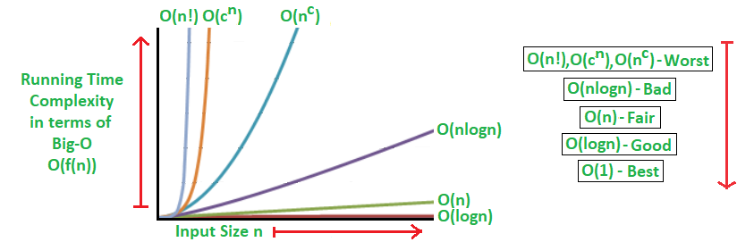
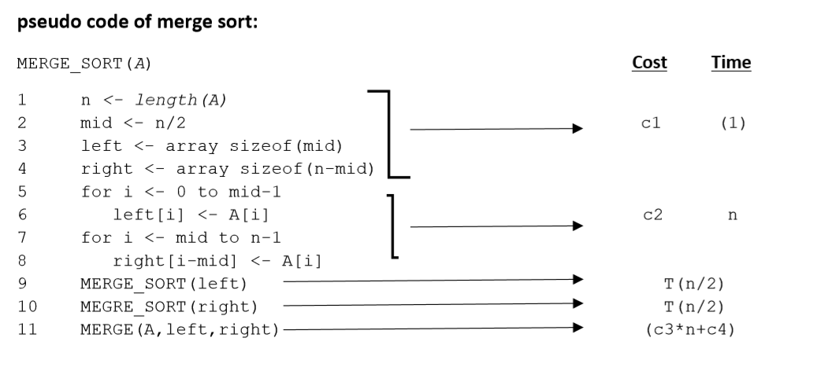
Complexity
Complexity
Analysis
The complexity of merge sort algorithm is O(nlogn)
QUANTUM_X

Slide 7
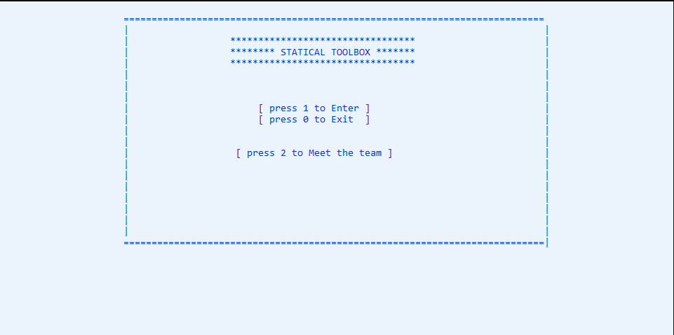
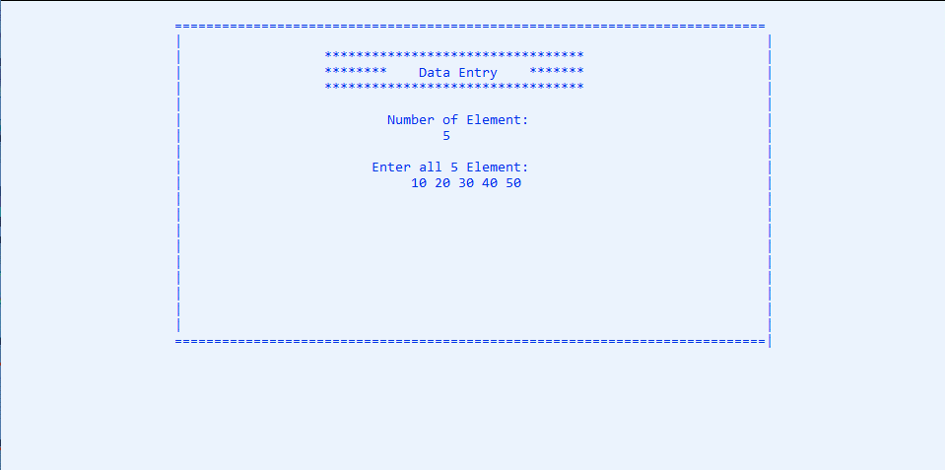
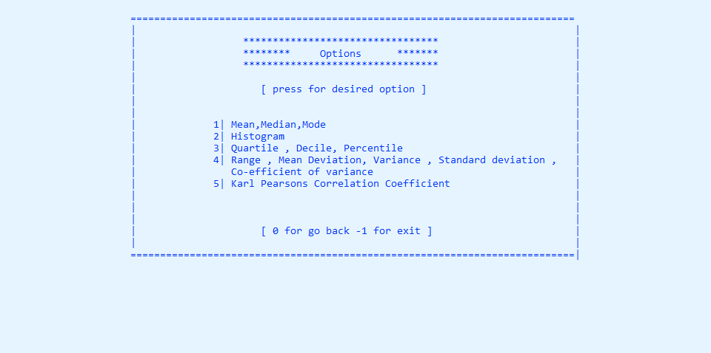
Project Layout
QUANTUM_X

Slide 8
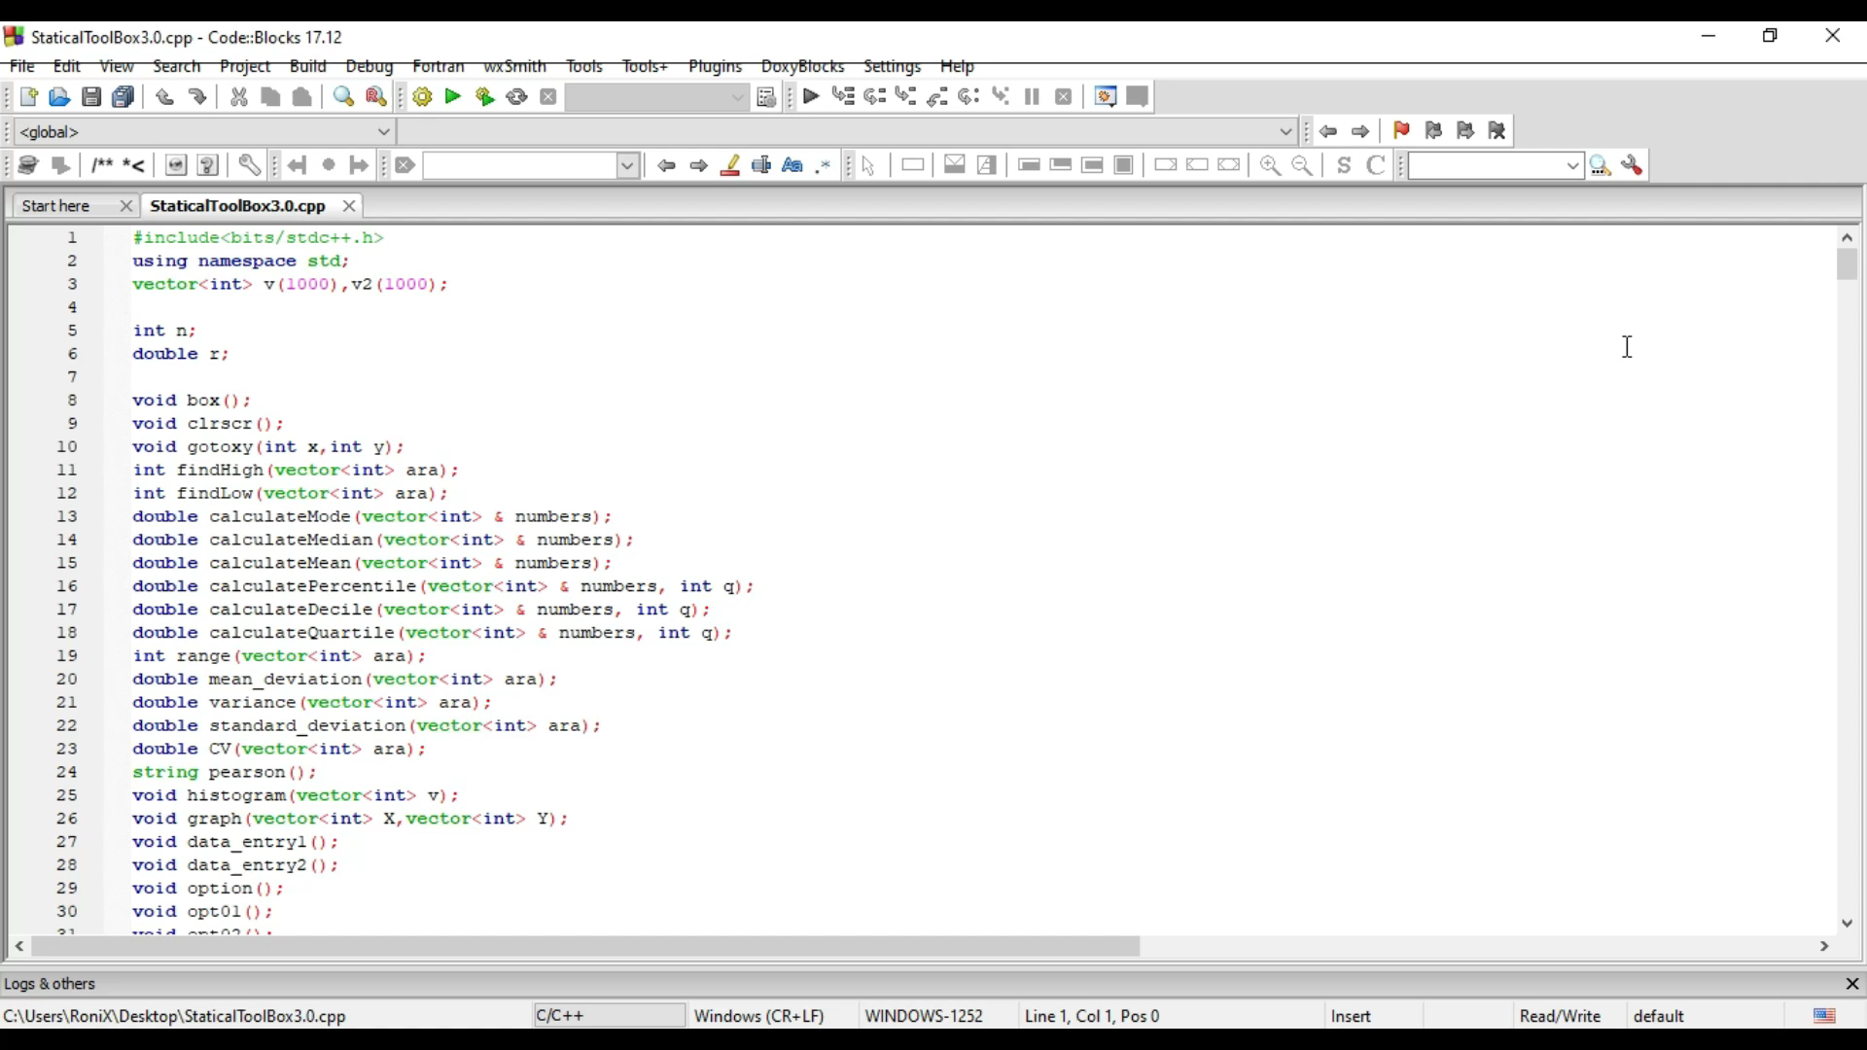
How it works
QUANTUM_X

Slide 9

Backend Code
😉
Have a look at our code used in this project
Click here → Statistical Toolbox
QUANTUM_X

Slide 10




Possible Challenges
Graphical Representation
Best Algorithm Selection
UI Design
Coding
Complexity
QUANTUM_X

Slide 11
It’s NOT just about ideas
It’s about
MAKING IDEAS HAPPEN
THANK YOU !
QUANTUM_X

